Slide 1
intelligent mosaic image generator
Zhao Ruizhou
Li Xianhan
He Yetao

Slide 2
partA
A mosaic generator

Slide 3
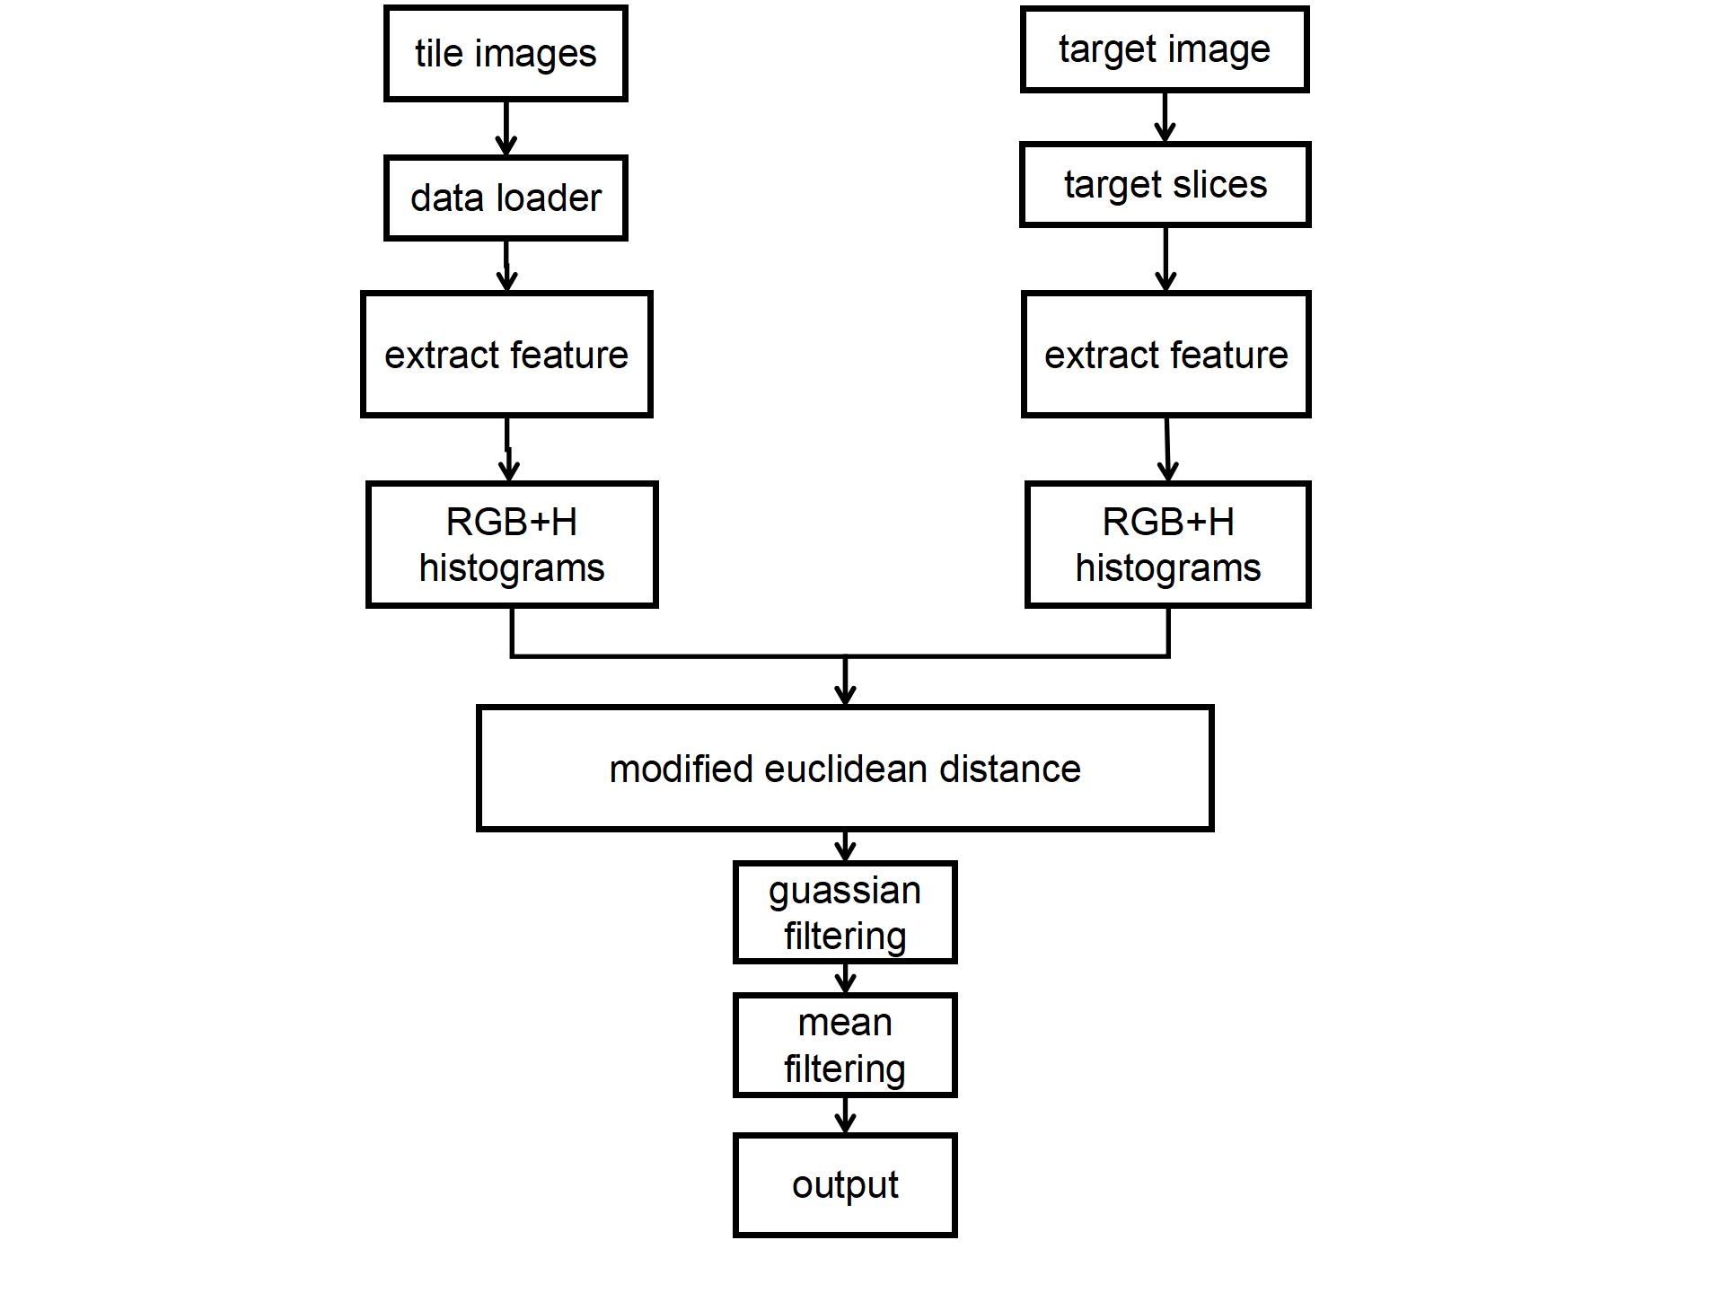
partA:
A mosaic generator
points:
Features: RGB + H
Polarized euclidean distance

Slide 4
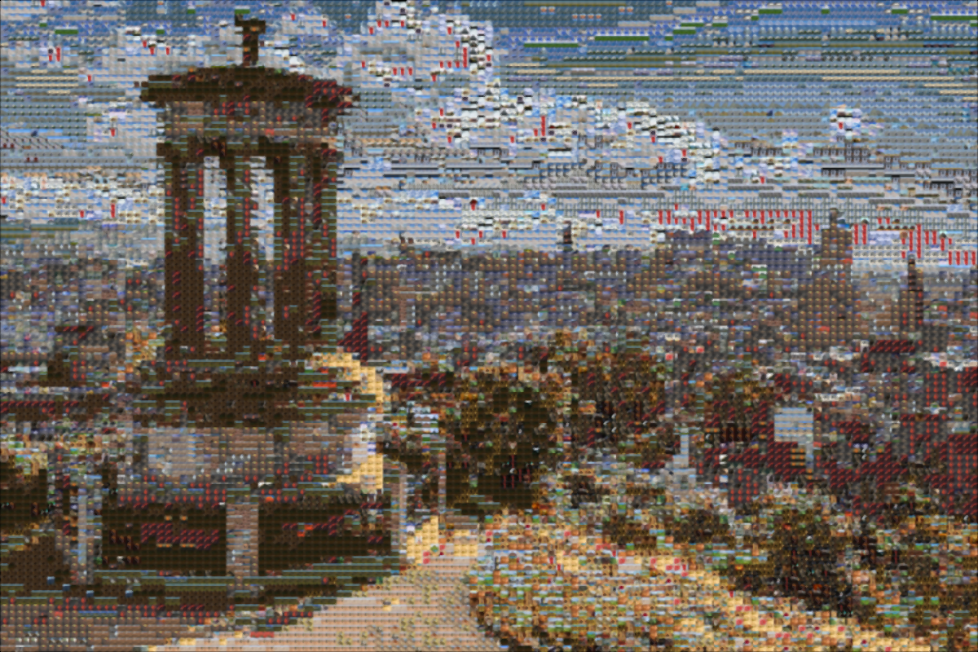
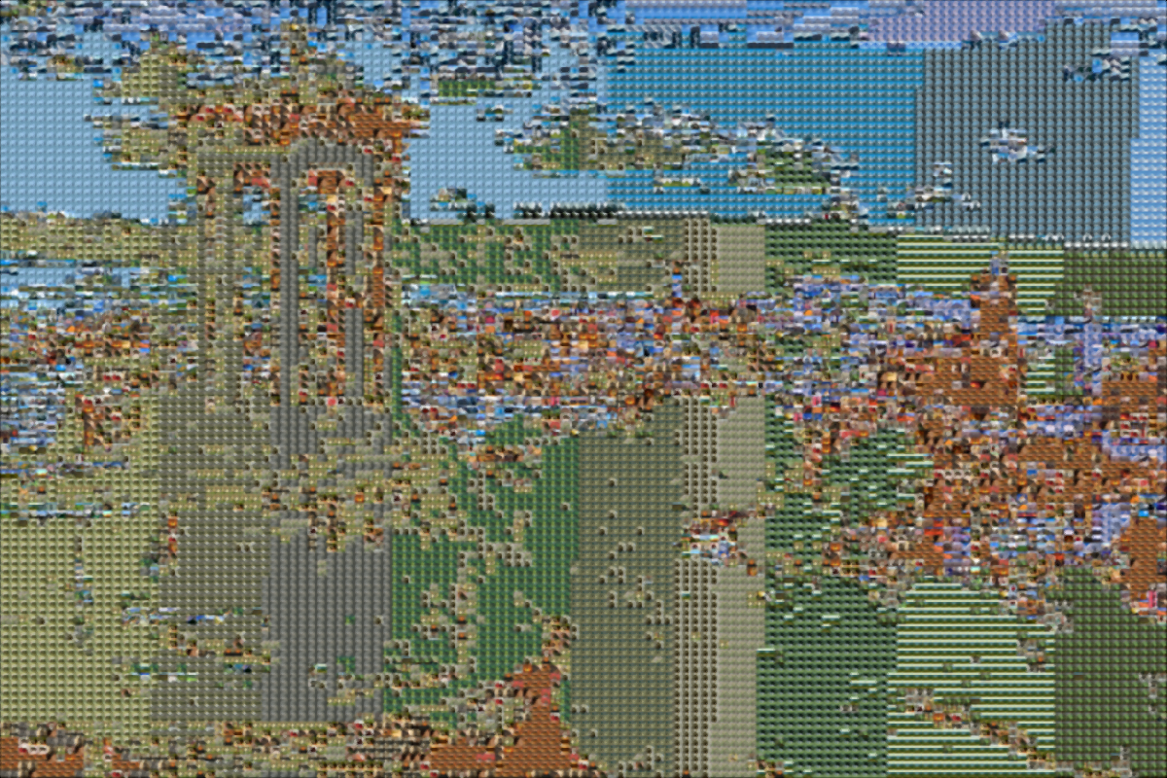
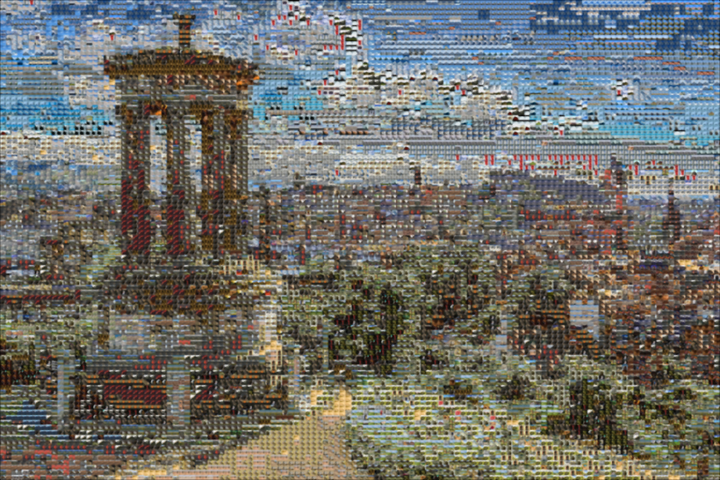
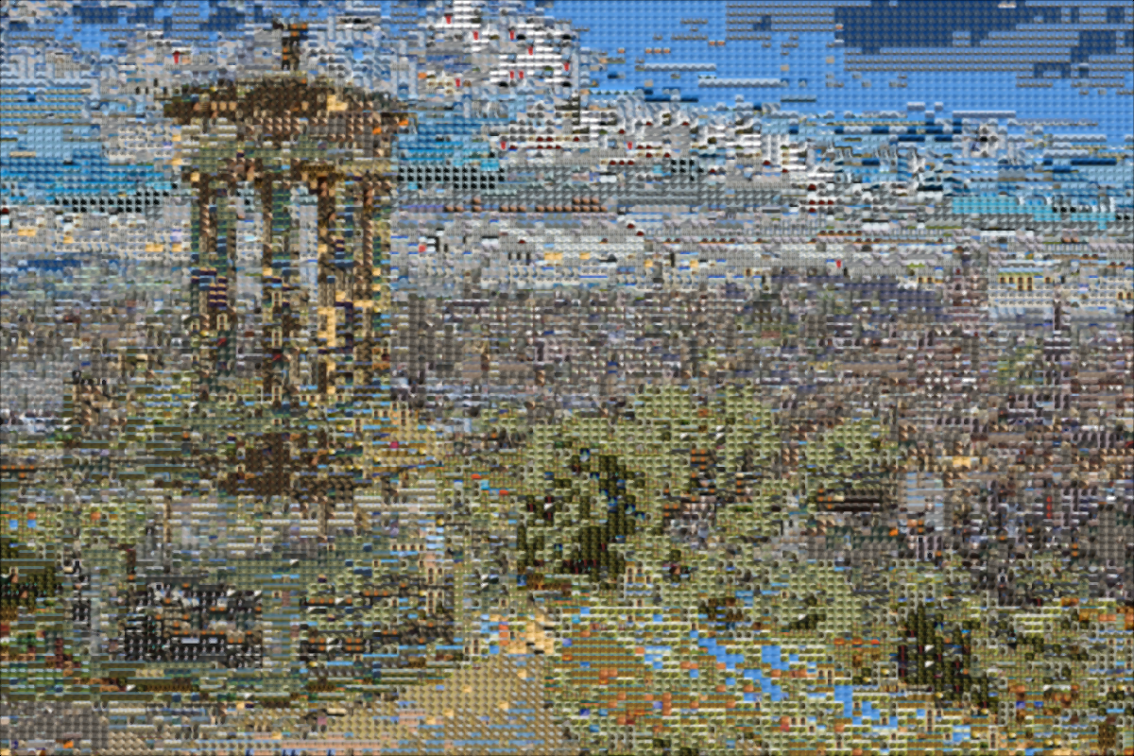
RGB
LAB
Features
RGB:
light
shadow
structure
H:
color
RGBH
HSV

Slide 5
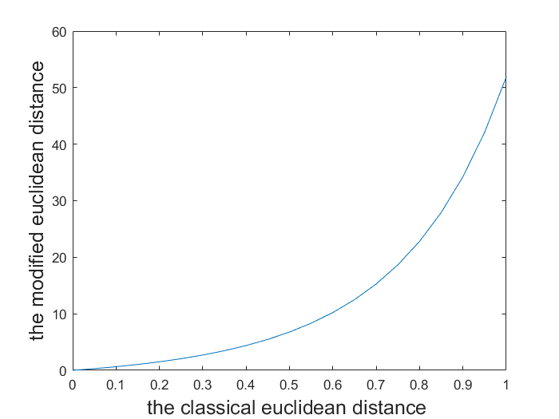
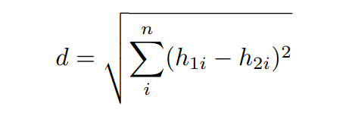
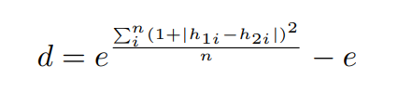
Polarized Euclidean Distance
polarize classical euclidean distance to push
unwanted colors away!

Slide 6
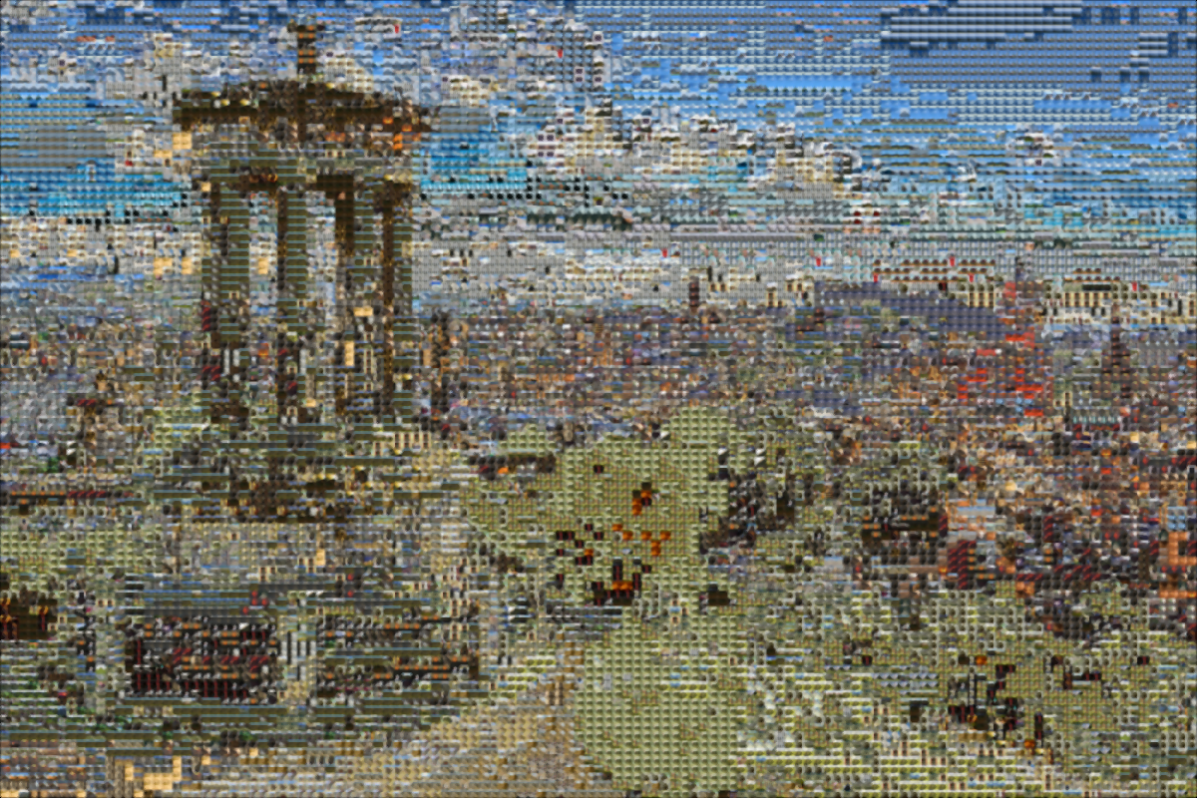
Polarized Euclidean Distance
classical euclidean distance
polarized euclidean distance

Slide 7
time
12000 tiles ≈ 180s

Slide 8
partA Supplement
Image Similarity and methods contrast

Slide 9
Pixels and Tiles Number Selection
Target Image Division and Source Image Size Adjustment
Image MSE
RGB Histogram Distance
Four Algorithms of Image Similarity Computation
HSV Histogram Distance
Color Correlogram

Slide 10
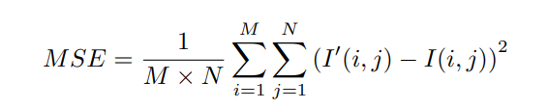
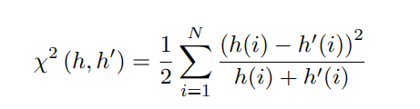
Image MSE
RGB Histogram Distance

Slide 11
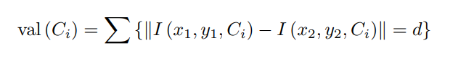
HSV Histogram Distance
I = rgb2hsv( I ) ; % From RGB t o HSV
Color Correlogram

Slide 12
Part B
Image classifier ----------- natural or man-made

Slide 13
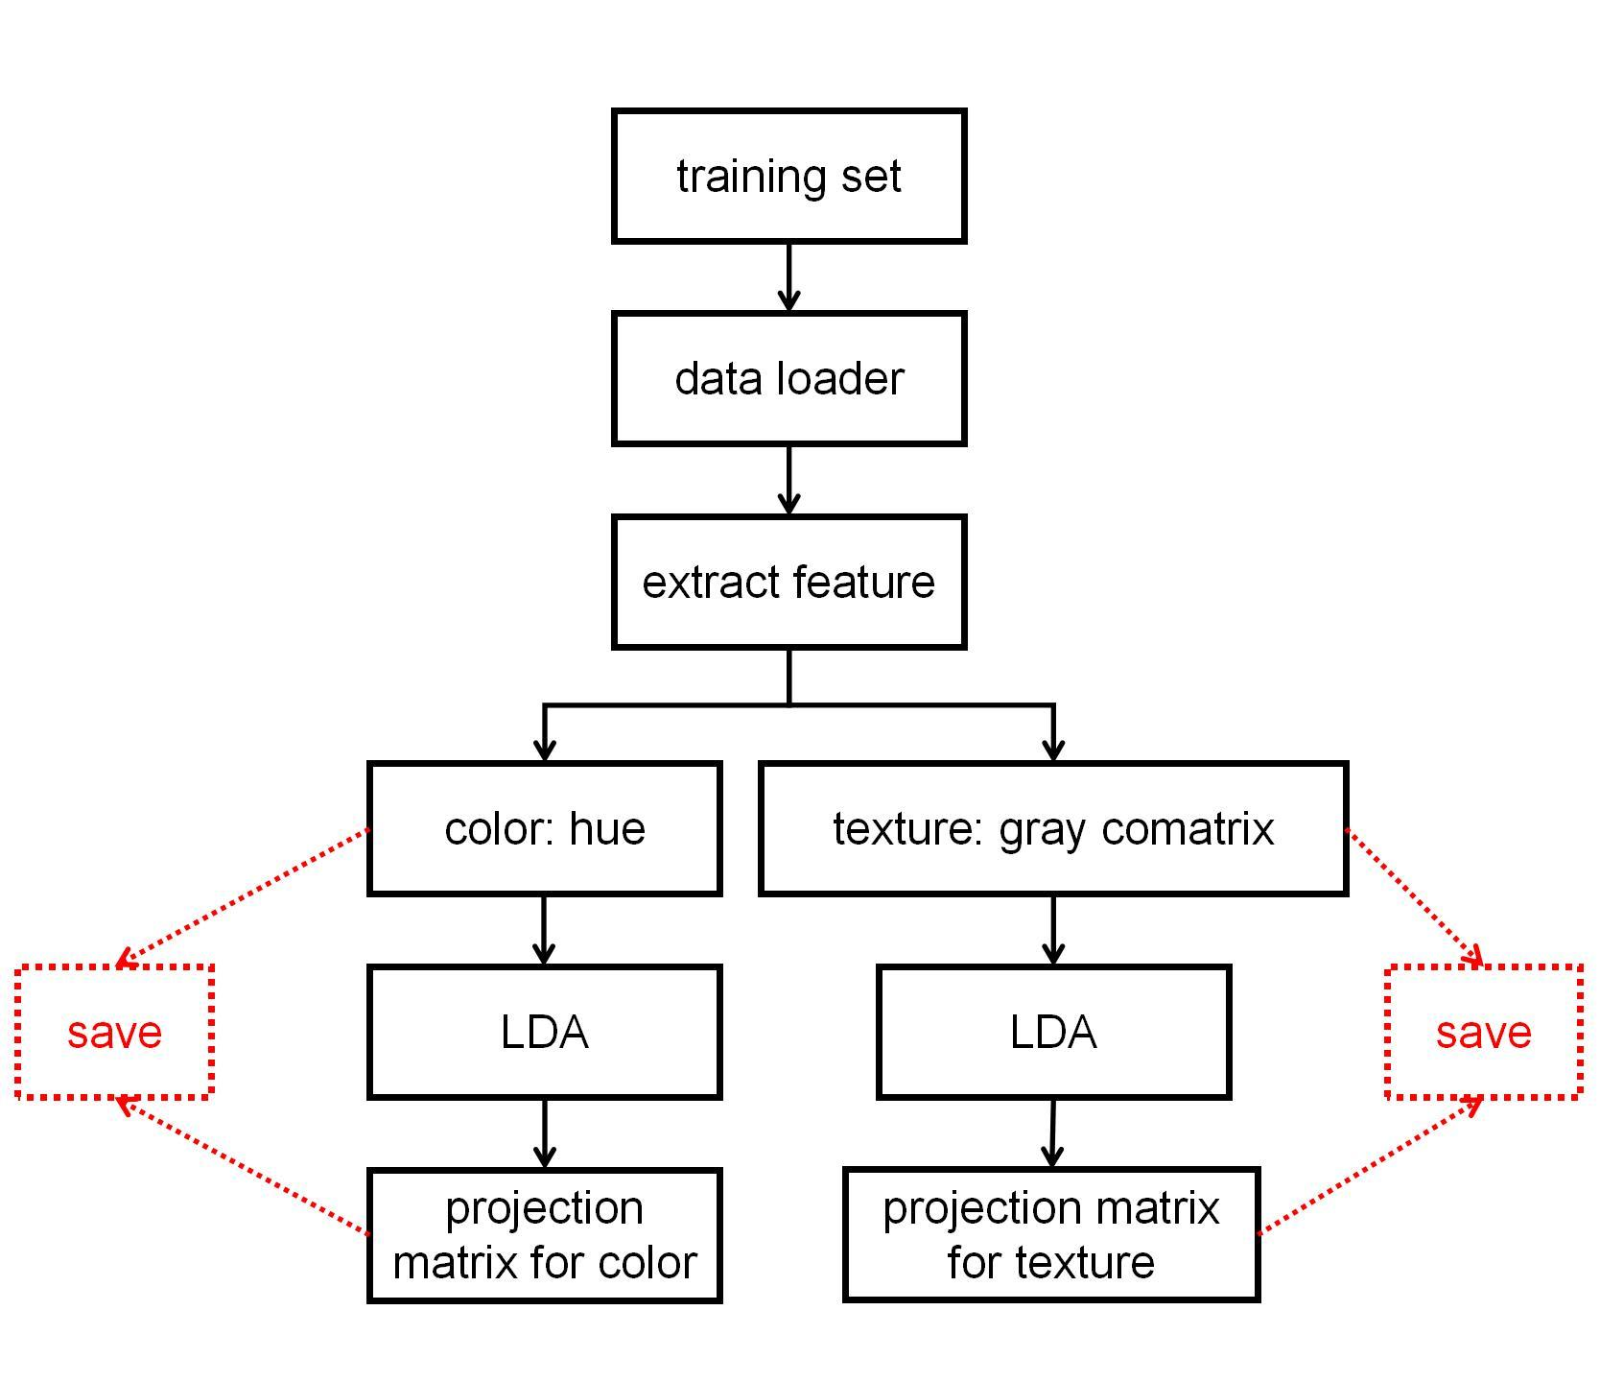
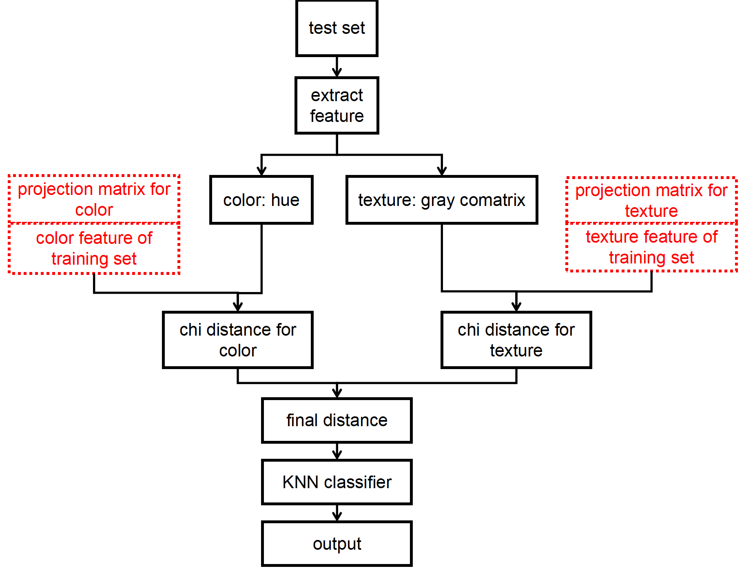
Overview of Part B
Training
Test

Slide 14
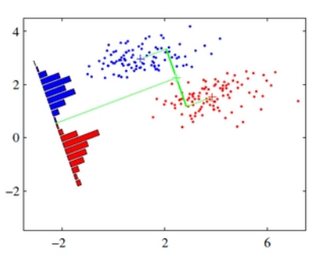
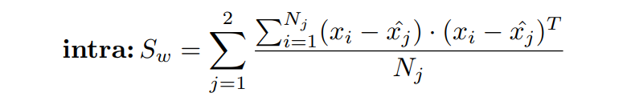
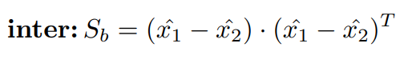
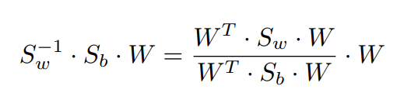
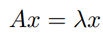
LDA
reduce feature dimensions or extract new powerful features or project to a distinctive coordinate system

Slide 15
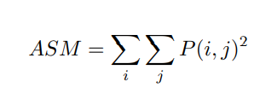
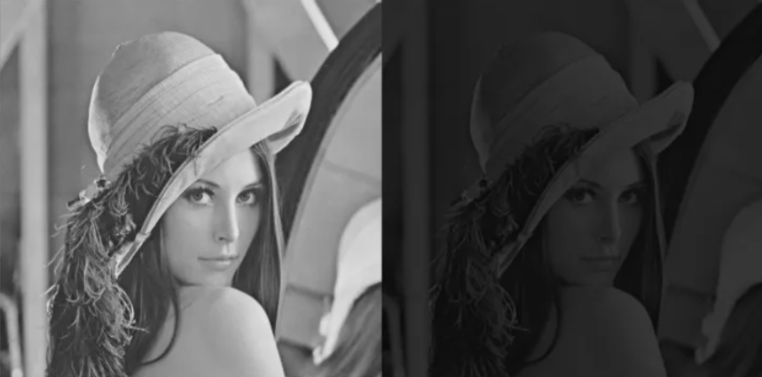
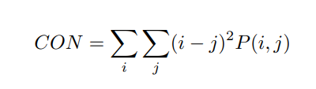
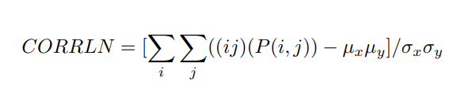
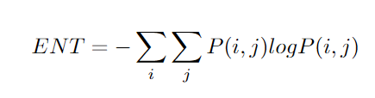
Gray Level Co-occurrence (GLCM)
Four features are used to extract the texture features of images

Slide 16
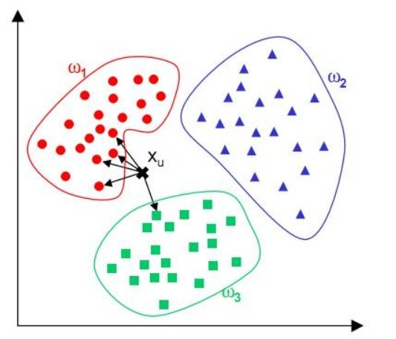
K-nearest neighbor classifier
①Calculate the distance between the points that you want to classify and the remaining points;
②Arrange in ascending order of distance, and select the first K (K of KNN) point, that is, the nearest K point to the sample point;
③Get weighted average, to get the answer;

Slide 17
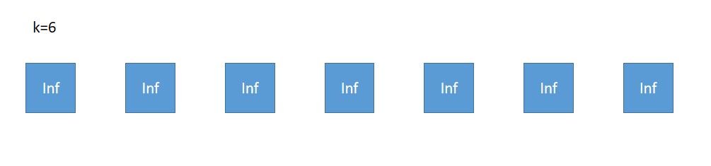
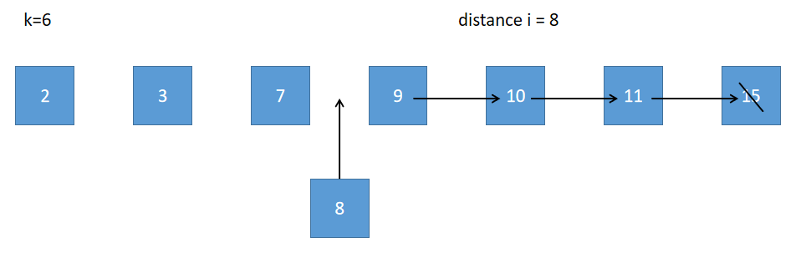
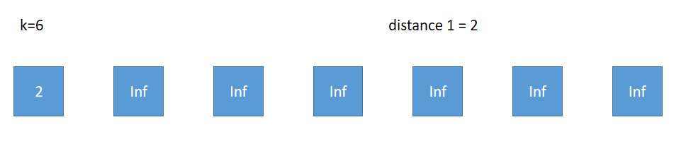
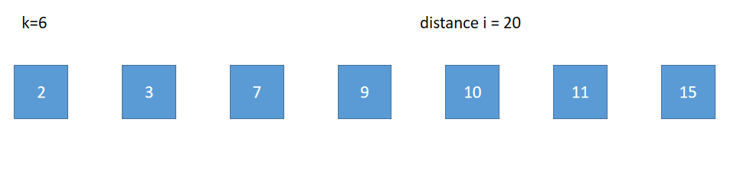
Insertion sort application
-------sort the distance
Give initial value: Inf
Insert if next distance is larger
Compare form front to back
Do not insert if larger than all

Slide 18
Get weighted average
label = 0(natural)/1(man-made)
d1
d2
d3
...
di
...
dk
distance
small
large
label
l1
l2
li
weight
k/sum
(k-1)/sum
(k-i+1)/sum
sum = [(1+k)*k]/2
total labeli*weighti＞= 0.5, or not?

Slide 19
Analyze and compare schemes
Try to choose a value as small as possible on the premise that the accuracy is stable and high.
Time Consuming
Unstable

Slide 21
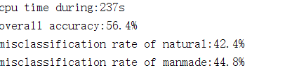
Analyze and compare schemes
RGB Channels are not appropriate.
Adding S and V actually introduces noise and reduces the accuracy.
L channel can be very time-consuming.
Adding A and B can also reduce the accuracy.
Best Choice: H channel

Slide 22
Analyze and compare schemes
After adding grey-comatrix, we find that the accuracy is greatly improved.
Finally, we choose H channel + Texture, and k = 39.

Slide 23
Part C
Combine the work done in Parts A and B to generate synthetic images for a specific class.

Slide 24
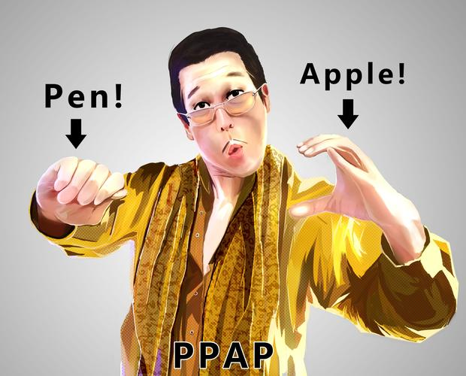
Combination of Part A and Part B
Preprocess the images in Part A and B.
Store the information into the mat files, move to part C.
Do Part B and Part A on a single target images.

Slide 25
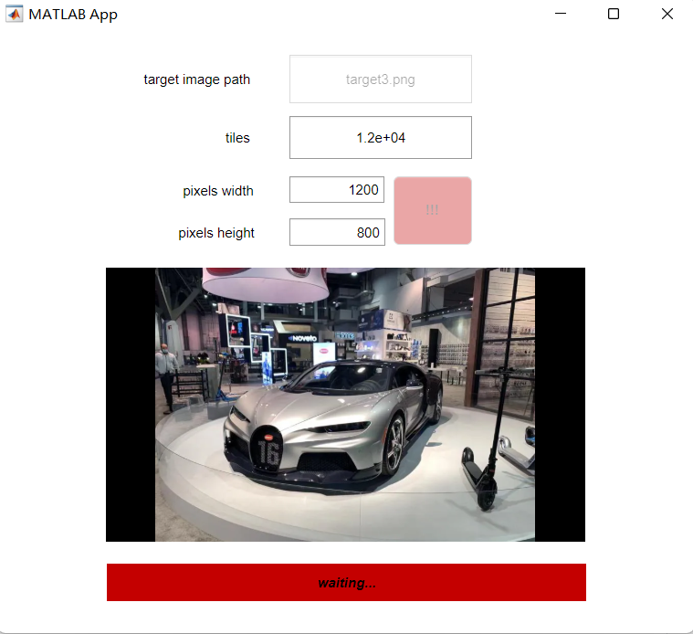
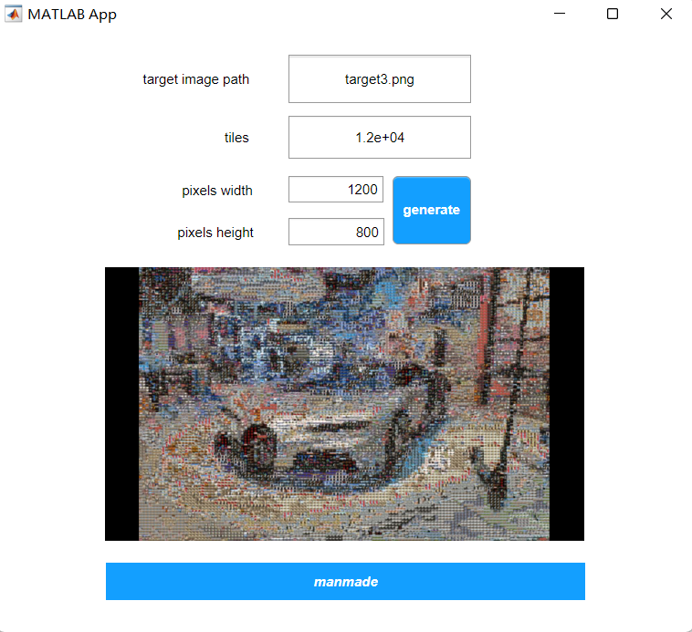
Combination of Part A and Part B
GUI

Slide 26
thank you all !
contribution:
Zhao Ruizhou: supplement for part A + GLCM in part B
Li Xianhan: part B + part C + part D
He Yetao: part A + LDA in part B + GUI

